Slide 1

6th Grade Accelerated Math
Unit 6, Lesson 4 Adding Integers Using Number Lines Volume 1, pg. 249

Slide 2


Benchmark
MA.6.NSO.4.1
Apply and extend previous understandings of operations with whole numbers to add and subtract integers with procedural fluency.
volume 1, pg. 249

Slide 3

Learning Target
I can add integers using a number line.
volume 1, pg. 249

Slide 4

Warm-Up
volume 1, pg. 249

Slide 5
6.4.1 Warm-Up: Speed Is Not Important
How fast you perform calculations in mathematics is not at
all related to how “good” you are at math. Fast calculation
is not important. What matters is deep thinking and
understanding.
Describe a time when you felt rushed to perform calculations on a math assignment or assessment.
If you were given as much time as you needed in the situation you described, how would that have affected your feelings and performance on completing the assignment or assessment?
volume 1, pg. 249

Slide 6

Refresher
volume 1, pg. 250

Slide 7

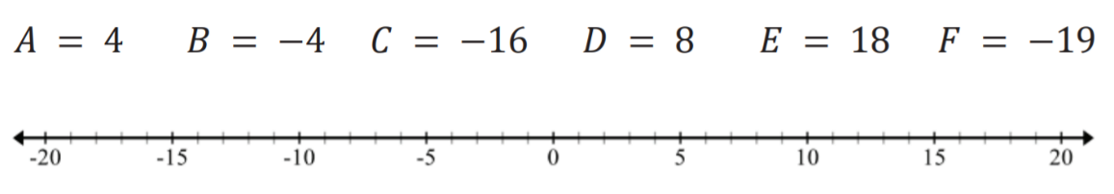
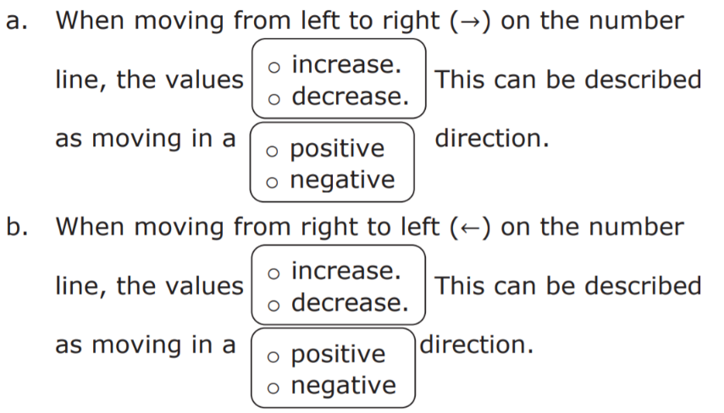
6.4.2 Refresher: Plotting Numbers on a Number Line
Plot each of the following integers on the number line below. Label each point with the letter indicated.
2. Complete the statements.
volume 1, pg. 250

Slide 8

Guided Instruction
volume 1, pg. 250

Slide 9
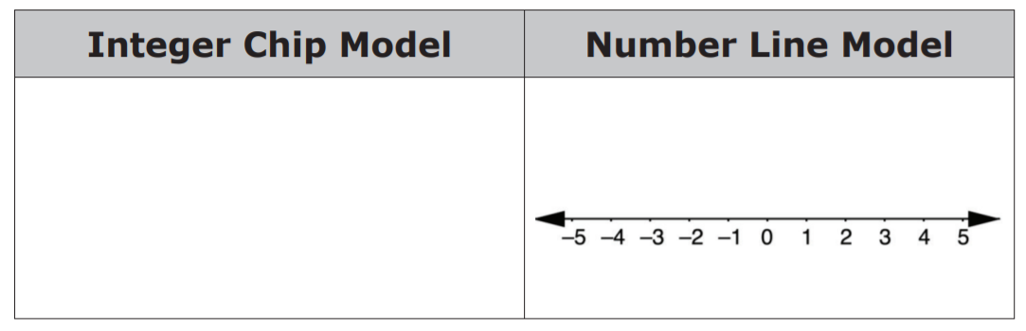
6.4.3 Guided Instruction: Rules for Adding Integers on a Number Line
In addition to integer chips, number lines are another helpful tool you can use to model adding integers.
1. Complete the following to model integer addition.
−3 + (−2) = ___________
volume 1, pg. 250

Slide 10
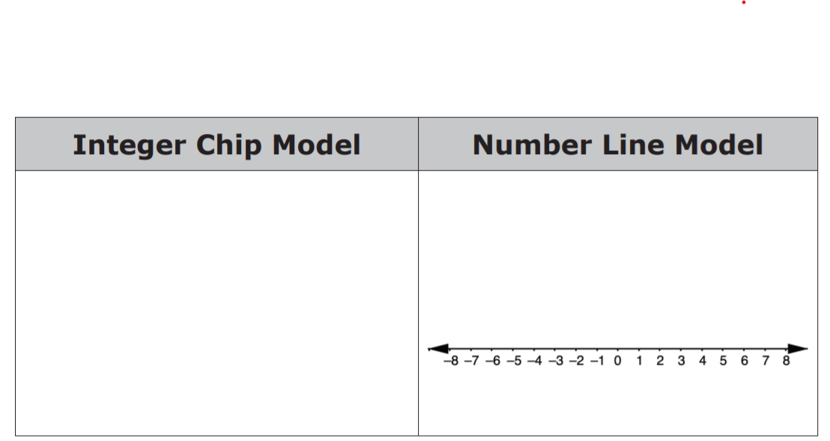
4 + (−7) = ___________
volume 1, pg. 250

Slide 11
2. The sum of integers can be represented using rays on a
number line. A ray has a single endpoint and extends in
a specified direction based on the sign of the integer.
• A ray that represents a positive integer has its
endpoint at 0, with the arrow extending to the
____________.
• A ray that represents a negative integer has its
endpoint at 0, with the arrow extending to the
____________.
• To represent a sum, draw a ray for the first integer
that starts at 0 and extends in the direction
indicated by the ____________ of the first integer.
It ends at the location of the first integer on the
number line.
volume 1, pg. 251

Slide 12
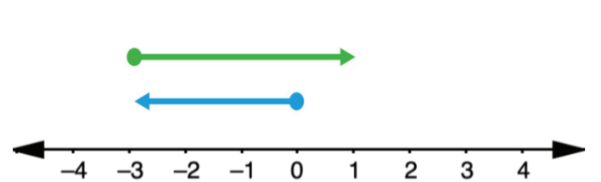
Then, draw a ray for the second integer that starts
where the first ray’s arrow ends and extends in the
direction indicated by the ____________ of the
second integer. It ends after moving the number of
units indicated by the second integer.
• The sum of the two integers is the integer where
the second ray ends.
3. The diagram shown represents −3 + 4 = +1
Give an example or explain when a number line model would be more useful than using integer chips.
volume 1, pg. 251

Slide 13

Collaboration
volume 1, pg. 251

Slide 14

6.4.4 Collaboration: Commutative Property
The commutative property of addition states that the order in which addition is performed does not change the value of the expression.
With your partner, add integers using the commutative
property.
Complete the table by sketching the integer chip model for the first column, the number line model for the third column, and answering the question in the last column.
volume 1, pg. 251

Slide 15
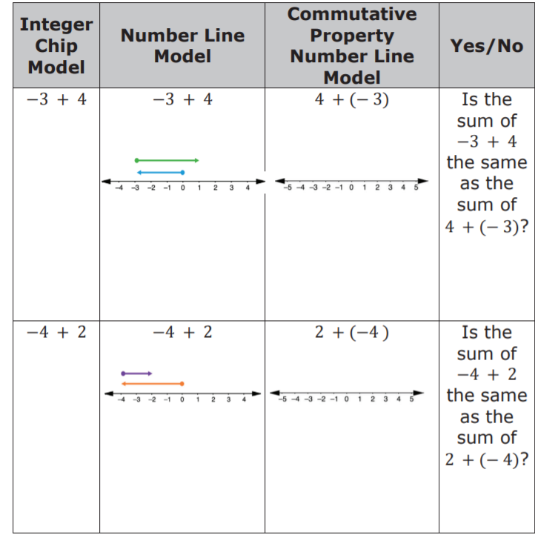
volume 1, pg. 251

Slide 16
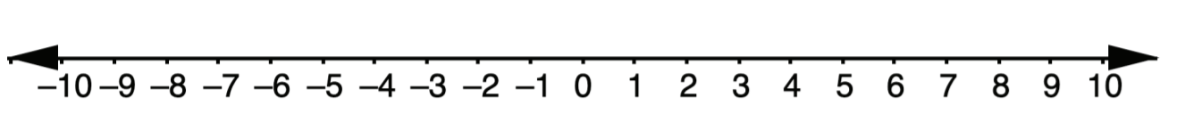

Show the model for (−7) + 9 on the number line below.
Show the model for 9 + (−7) on the number line below.
Discuss with your partner how the two number line models for (−7) + 9 and 9 + (−7) show that (−7) + 9 = 9 + (−7). Write a summary of your reasoning.
volume 1, pg. 252

Slide 17

Try It
volume 1, pg. 252

Slide 18

6.4.5 Try It: Adding Integers Using Number Lines
Find each sum. Use the number line to model the addition.
a. 8 + (−18) = ________
b. −7 + (−5) = ________
c. −3 + 20 = ________
volume 1, pg. 252

Slide 19
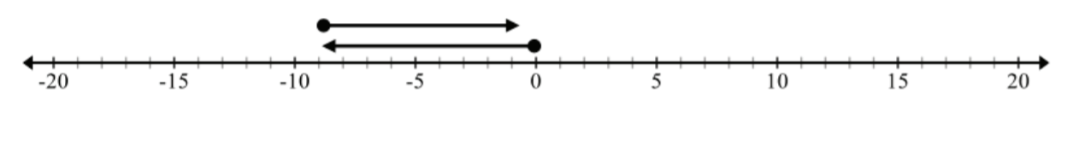
Write the numerical expression for the model below. Then, find the sum.
volume 1, pg. 252

Slide 20

Your Turn
volume 1, pg. 253

Slide 21
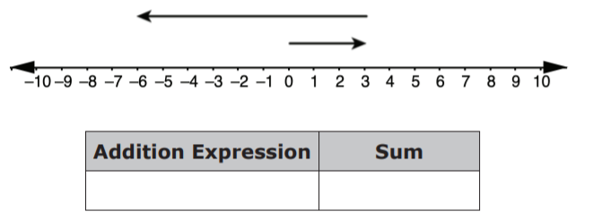
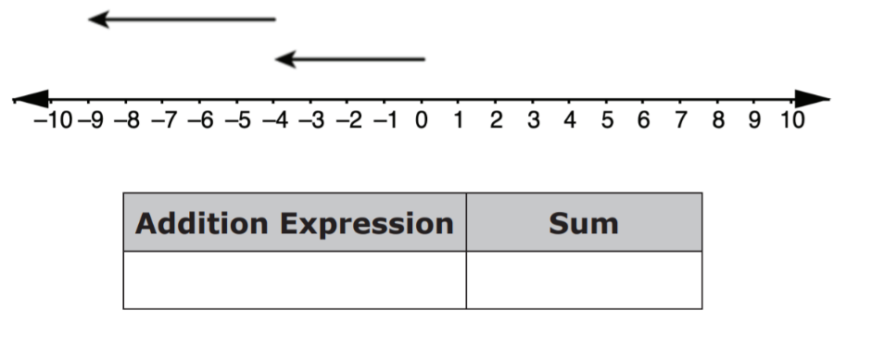
6.4.6 Your Turn!
For each number line model, write the addition expression represented and find the sum.
a.
b.
volume 1, pg. 253

Slide 22
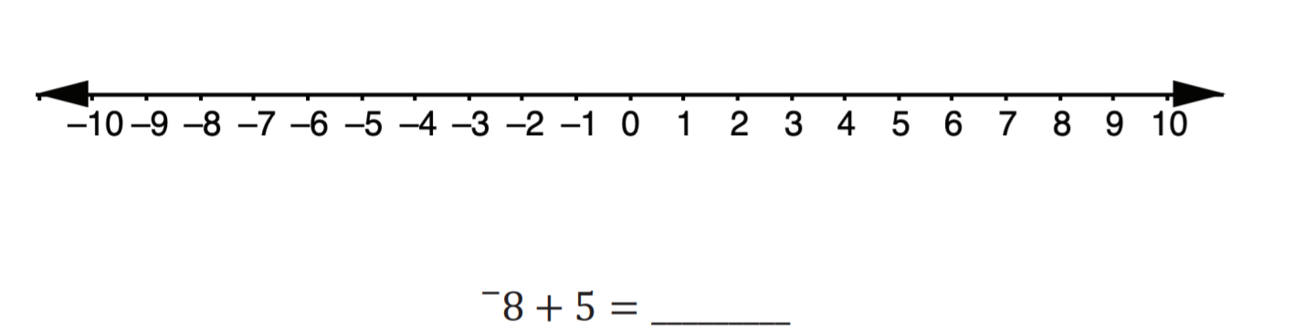
2. Use the number line to show the sum of
-8+5. Then, complete the equation.
volume 1, pg. 253

Slide 23

In a single day, the temperature in degrees Fahrenheit (℉) of a town in Canada began at a low of −20℉ and increased 40℉ by noon.
Plot a point at the low temperature.
Draw a ray along the number line to represent the increase of 40℉.
Which direction does the arrow extend to show the increase in temperature?
What was the temperature in the town by noon?
volume 1, pg. 253

Slide 24

Wrap-Up
volume 1, pg. 254

Slide 25
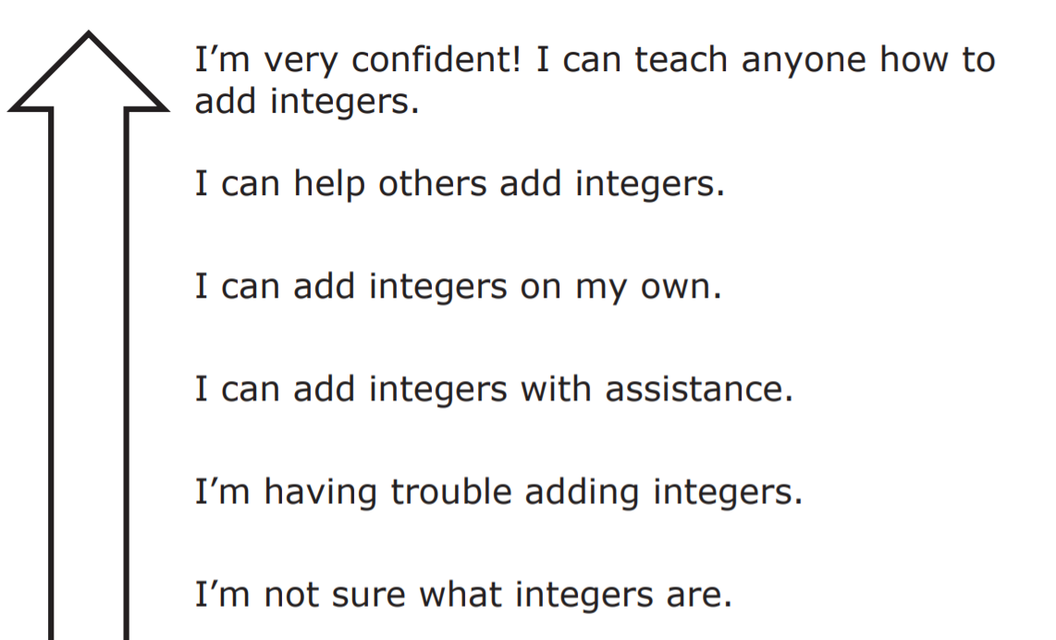
6.4.7 Wrap-Up: Reflection
Color in the arrow up to the statement that best describes your current level of confidence with using a number line to add integers.
volume 1, pg. 254

